Slide 1
DIABETES - SOCIAL MEDIA ANALYSIS
This report analyzes online and consumer generated media conversation discussing ‘Diabetes’ during the period of May18 – Nov 18, 2016. Coverage was gathered from various social media platforms using multiple social media monitoring tools.

Slide 2
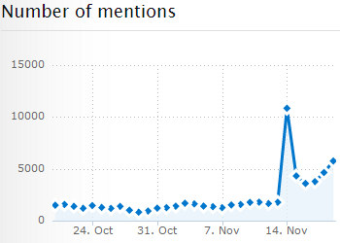
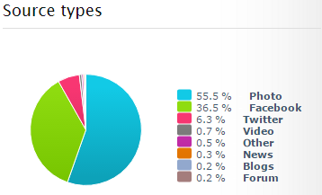
summary
The total conversations about Diabetes on social, mainstream and consumer generated media (CGM) was 60464 with estimated reach of around 202M users for the period of Oct 18 to Nov 19, 2016. There was a gradual increase in volume at start of November, followed by huge spike in volume of 491% on 14th November. The volume on Facebook, YouTube and Instagram tended to rise and fall in alignment. However, Twitter volume did not generally follow the same topics as the rest of social media.
Unique topics of note are shown in the diagram below. The main theme in coverage dealt with ‘World Diabetes Day’ and ‘Diabetes Awareness Month’ followed by ‘Lifestyle choices’
World Diabetes Day
Diabetes Awareness Month
Increase in Lifestyle choices post on Twitter

Slide 3
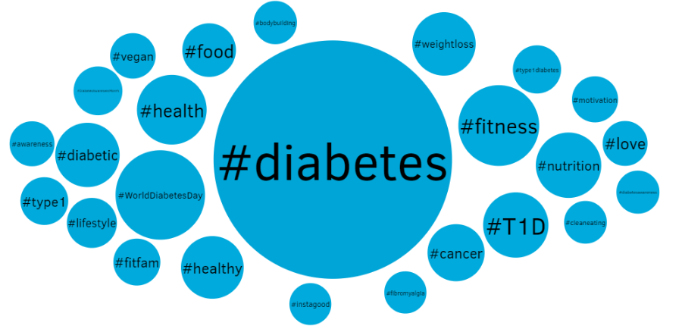
Word Cloud

Slide 4
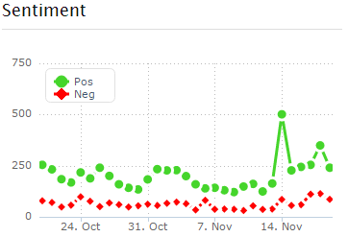
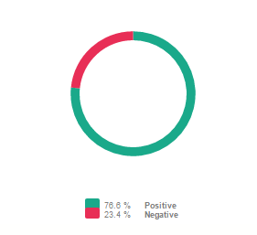
Sentiment Analysis
The general sentiment of the conversation was mostly neutral. Positive sentiments dominated the negative ones by 3:1. The number of positive sentiments increased by 75% on 1st Nov due to commencement of ‘Diabetes Awareness Month’ followed by a 300% spike on 14th Nov celebrated by ‘World Diabetes Day’. There was a surge in positive sentiment on 18th Nov which rose by 37% from previous day and could be shown in the figures below

Slide 5
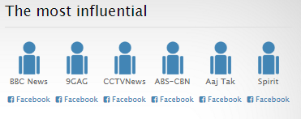
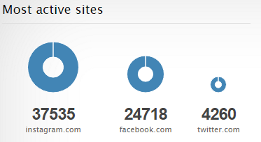
Influence and reach
It is observed that the mainstream media channels through their social media pages, especially Facebook have the maximum influence
Instagram, Facebook and Twitter are the most active social media sites for the conversations

Slide 6
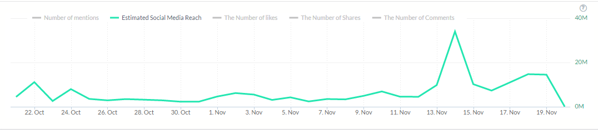
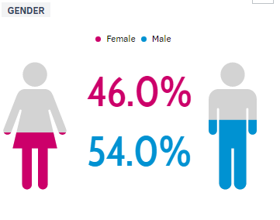
Influence and reach
The estimated reach is 202M over the period of given time. The reach rises and falls in alignment to the conversations over the period of time
It is observed that male participation and thus target audience is relatively more male than female

Slide 7
Conversation topic breakdown
Topic | Sentiment (P:N) | Volume | Influential Authors | Active Sites (In Order)
Medication / Brands | 5:4 | 1185 | Bayer, Neulife, PMO, WFAA TV | Facebook, Instagram, Twitter
Lifestyle choices | 14:3 | 4609 | Cleveland, Chef, Medical, Juicing, Nobel | Instagram, Facebook, Twitter
Side effects | 8:3 | 465 | BBC, 9GAG, CCTV, | Instagram, Facebook, Twitter
Accessibility | 5:2 | 495 | Access, Nobel, United Health, NewsRoom | Facebook, Instagram, Twitter
Cost | 7:1 | 44 | Support, Flythe, NBC, The Diabetic Chef | Facebook, Reddit, Instagram

Slide 8
Insights
Diabetes has awareness across all the social media platforms with many authors discussing about the ailments.
Facebook, Instagram and Twitter are main broadcasting platforms of discussion
Diabetes has increased awareness in the month of November, with it reaching peak on 14th November on World Diabetes Day. The estimated reach for the current period is 202 Million
The overall sentiment about Diabetes and several features associated with it such as ‘lifestyle choice’ is positive. With positivity reaching its peak on World Diabetes Day
Bayer has the maximum influence and brand to observe
Both the genders are target audience here, with slightly more male participation than females (54% Males to 46% Women)

Slide 9
Recommendations and implications
Facebook, Instagram and Twitter should be primary platform to reach audience to create max influence
One should start the campaign during the month of November to influence maximum audience with boosted efforts on and after 14th November when the audience engagement is at its peak
One should focus on ‘Lifestyle choice’ associated with diabetes as the topic is trending currently
Should focus on products addressing issues of both genders as both have substantial engagement

Slide 10
Methodology Section
Social Media Platforms: Facebook, Instagram, Twitter, Reddit, Blogs, News platforms, Forums and web
Data: Data extracted through platform API’s linked with social media listening tools
Social Media Tools:
Brand24: Tool provides comprehensive data in a visually appealing format of current trends
Mention: Provides added features to create a complete report like word cloud and alerts and gender distribution
Talkwalker: Helped in analyze platforms such as blogs and forums to provide a user friendly report of the influencers
Social Mention: Used to gain an overall insight of the data used for trend analysis

